Slide 1


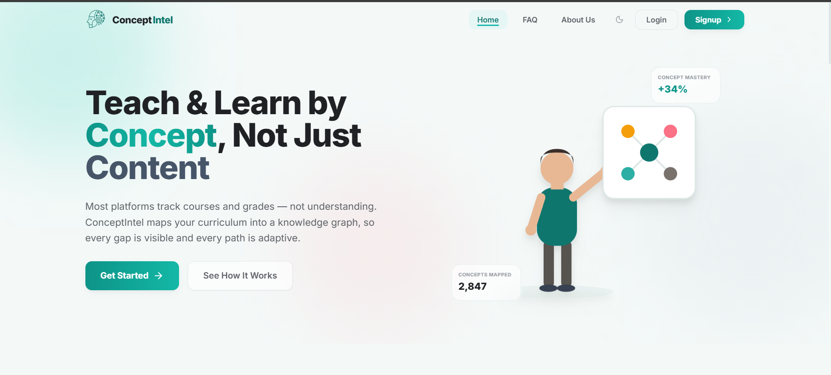

ConceptIntel;
A knowledge graph-based concept intelligence platform for teachers & students
The AI That Finally Teaches Universities What Their Students Don't Understand; Concept by Concept.
"Today's platforms grade the answer. ConceptIntel understands the gap."
Air University, Islamabad
Mamoona , Laiba , Muhammad Kashif
Supervisor: Assistant Professor (Dr. Sumaira Farid)
1

Slide 2






Product Snapshot
Product introduction
ConceptIntel serves university teachers and students in prerequisite-heavy STEM courses. Students never know which concept is weak they only get a score. Teachers never know which concept the whole class lacks, with no time to give concept-level feedback to every student. ConceptIntel builds a prerequisite knowledge graph, generates targeted content per concept, and its adaptive engine routes each student to what they're missing; teacher-reviewed first.
Innovation
Our single most innovative capability is the two-stage human-approval workflow for AI-generated knowledge graphs: AI proposes concepts and prerequisites, a teacher edits them, and a coordinator signs off before anything reaches a student.
Quality control
No formal certifications yet — this is an academic prototype. Our compliance evidence is architectural: role-based access across 5 tiers, JWT authentication, AI content sandboxed under a strict CSP, and full AI-call tracing via Langfuse. Every AI answer, including assignment feedback, is grounded through RAG with mandatory citations so nothing is generated ungrounded
CORE QUALIFICATION FIELDS
Founded in
Feb 2026; Air University FYP
Launched in
Prototype
Number of Clients
0 paying; 3 subjects validated
IP Owned
Yes
Business Model
SaaS (per-institution license)
₨
Revenue
Pre-revenue (FYP prototype)
Most Innovative Feature
Human-approved AI knowledge graph
✓
Licenses / Certifications
None formal — aligned to HEC CLO/PLO standards
Validated beyond the classroom — positive feedback from IEEE reviewer, our department HOD, and a professor from MBZUAI.

Slide 3




Why is your product ready for the P@SHA ICT Awards?
We are ready because we replace one-size-fits-all courseware with a governed AI knowledge graph, proven by three real university subjects tracked end-to-end, supported by human approval gates and a hallucination-mitigation RAG pipeline, and scalable to every HEC university that needs this.
Uniqueness
Teacher's own material becomes a live, editable knowledge graph.
Two-stage human approval (teacher → coordinator) before any AI-proposed concept or grade reaches a student.
ChatGPT explain concepts but have no idea what your course covers or where you're stuck ConceptIntel is grounded in the course's own material.
Built around HEC's own CLO/PLO course-outline format.
Market Potential
Target market: every HEC university with prerequisite-heavy STEM courses, starting with our own CS and Engineering departments. Business model: per-institution SaaS, layered on top of the LMS a university already pays for.
Growth: each knowledge graph is reused every semester, the second and third cohort onboard almost for free.
1
2
Functionalities & Features
Full pipeline, live end-to-end: upload with OCR, concept extraction, teacher and coordinator review, adaptive learning. Concept-level grading, mastery heatmaps, per-concept mini-games; not just a percentage score. Built on standard formats already in use: PDFs, PPTs, and HEC-format CLOs and PLOs.
4
Quality & Technology
Content & standards: a hallucination-mitigation layer,grounded RAG, calibrated thresholds, mandatory citations, full Langfuse tracing.
Stability & reliability: FastAPI, pgvector, Neo4j Aura, and a 3-provider LLM fallback so the assistant never hard-fails. Security: 5-tier RBAC, JWT auth, and CSP-sandboxed AI content.
3
Prerequisite chain proven end-to-end, Applied Physics to Digital Logic Design Praised by IEEE member, our HOD, and MBZUAI professor(impact).
Two-stage human-approval gate that no alternative offers (innovation).
A dedicated hallucination-mitigation layer (technology/quality)..

Slide 4
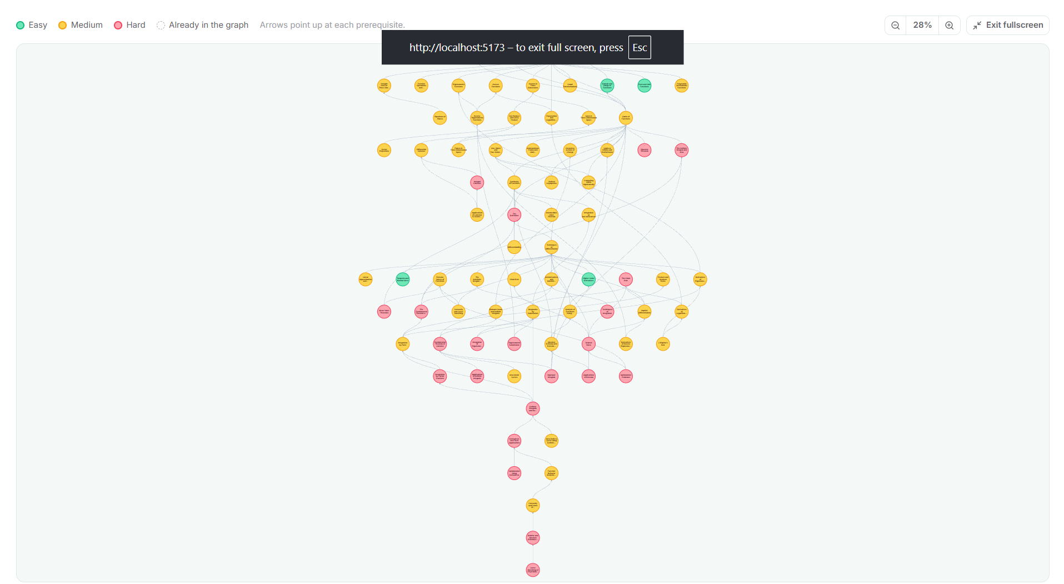
2
4

Slide 5
2
4

